Slide 1

Student project : 1st Checkpoint
Elaborated by : KARKENI Hazem

Slide 2
In this project we are going to answer/clarify the following statments :
How does the web work?
What do you need to be a web developer?
What is the role of a web developer?

Slide 3
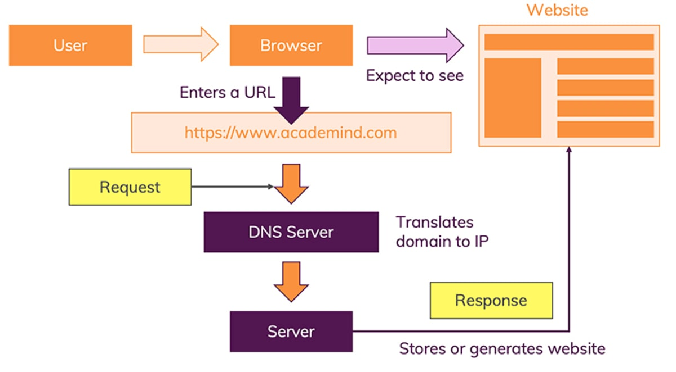
How does the web work?

Slide 4
What do you need to be a web developer? To be a web developer you need both of hard/soft skills
When it comes to soft skills, you will need to have the sense of :
Empathy
Communication
Teamwork
Approachability and Helpfulness
Patience
Open-mindedness
Problem solving
Accountability
Creativity
Time management
And the main hard skills are :
HTML/CSS skills
Analytical skills
Responsive design skills
JavaScript skills
Interpersonal skills
Testing and debugging skills
Back-end basics
Search engine optimization

Slide 5
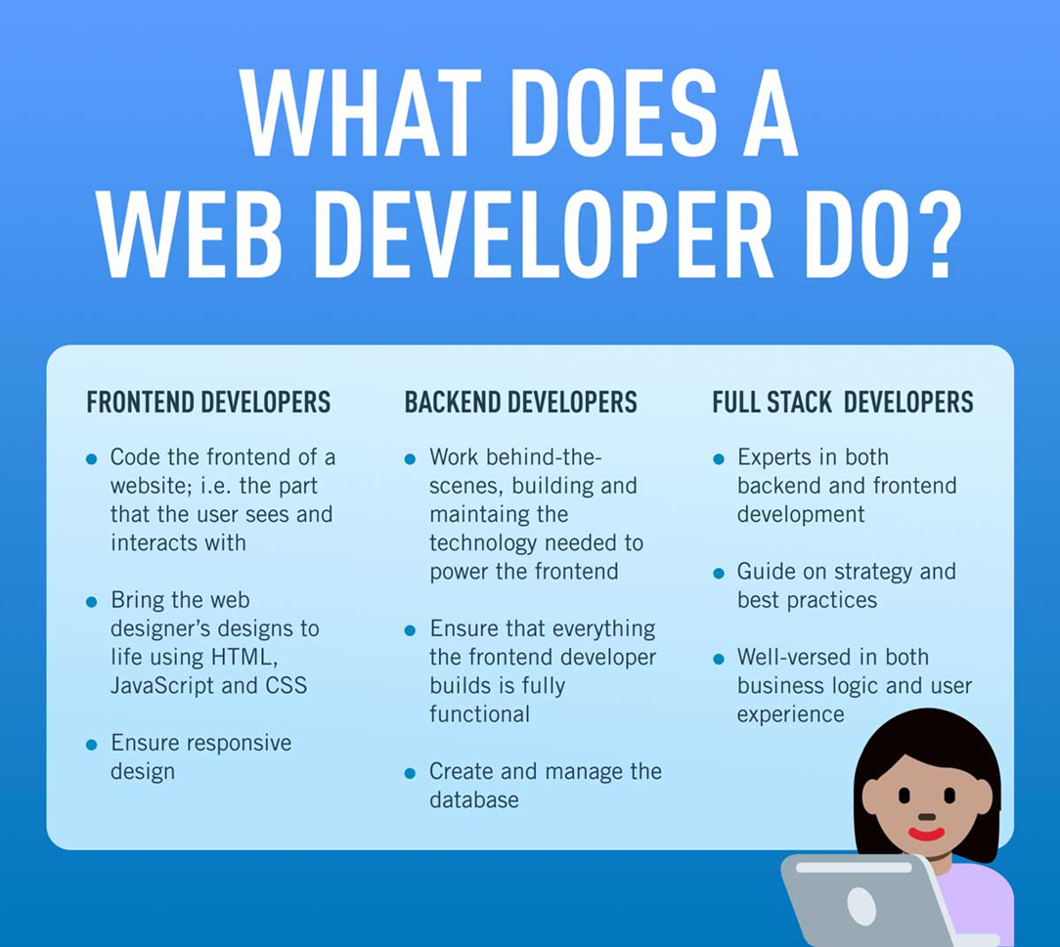
What is the role of a web developer?

